Slide 1

AIT 580 Riding the Data Wave : Uncovering Trends in Citi Bike usage in New Jersey and Hoboken City [2021 – 2023] - Ivan Francis AIT 580

Slide 2

Contents : Introduction Research Questions. Busiest Stations and usage patterns among Citi Bike Riders. Demographic Analysis on Citi Bike Users. Citi Bike usage patterns and trends based on customer types. Conclusion.

Slide 3

Introduction:
The Aim of this research is to understand the Citi Bike System data based on New Jersey and Hoboken City for the period of 2021 – 2023.
In the following slides, we want to answer the research questions utilizing the insights and exploratory data analysis done in the project.

Slide 4
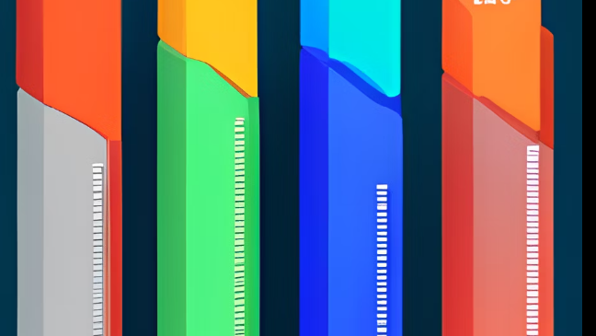
RESEARCH QUESTIONS: What are the busiest bike rental locations in New Jersey and Hoboken City and how do usage patterns change over the day, week, and season? Are there any demographic factors/patterns that are visible when considering the Age and Gender of the riders utilizing the Citi Bike transport system ? Are there any usage patterns or differences that can be observed between users or riders who are of two categories that are casual and members.

Slide 5
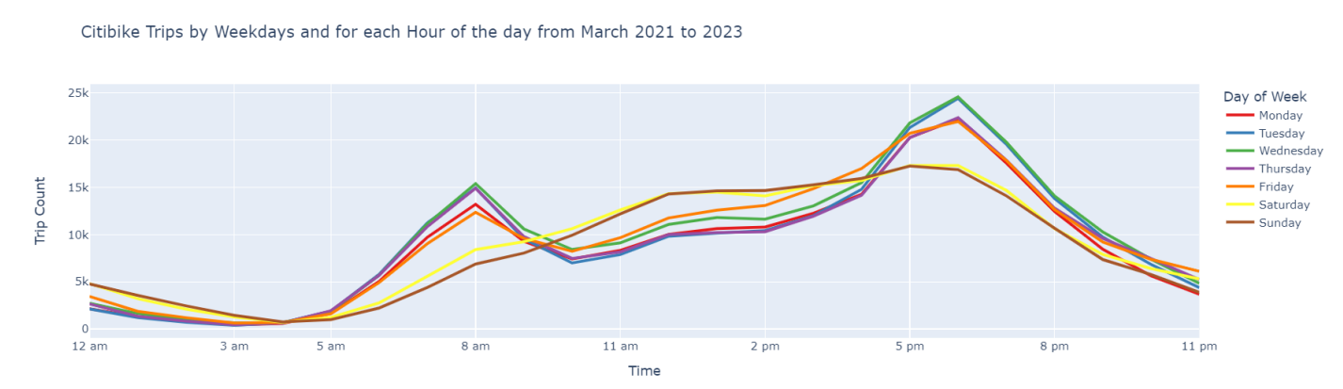
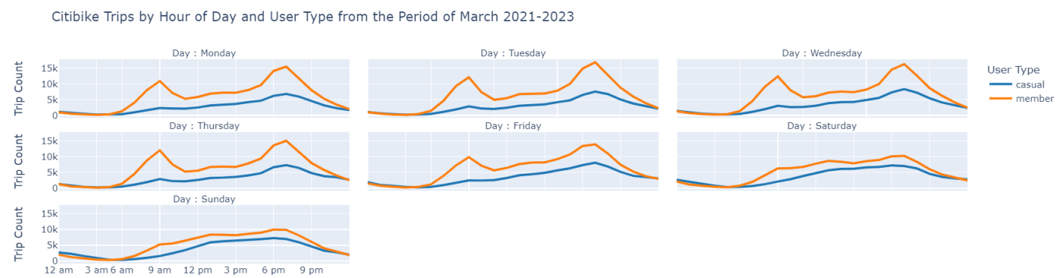

Slide 6
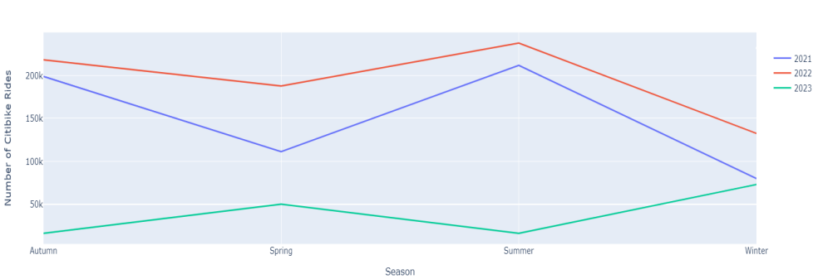
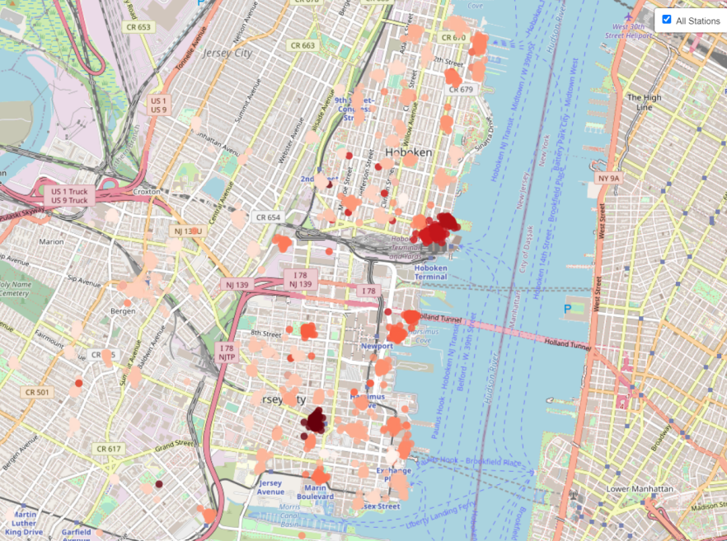
Seasonal Trend/Pattern for Citi Bike Rides from March 2021-23
Map plot for the busiest bikes stations in New Jersey and Hoboken City. Where darker the marker gets denser and more utilized the stations are by people using Citi Bike

Slide 7
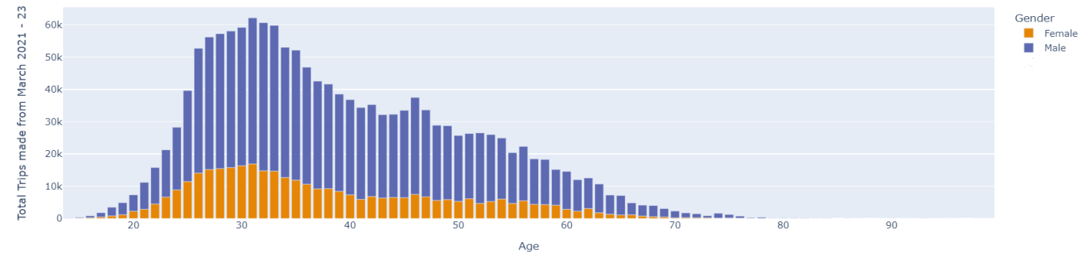
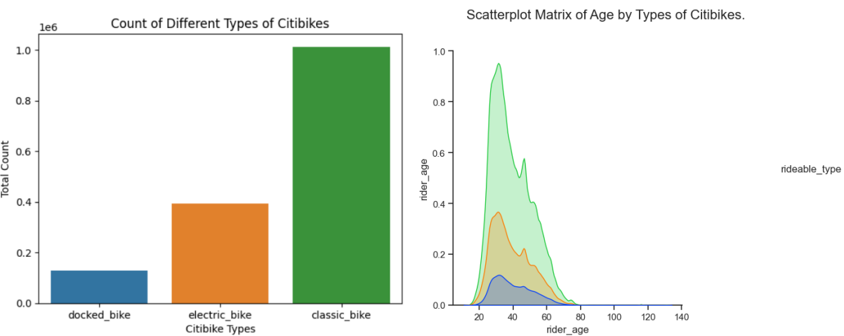
Analysis based on people using Citi Bikes based on their Age and Gender.
Different Types of Citi Bikes and how are they utilized by the population.

Slide 8
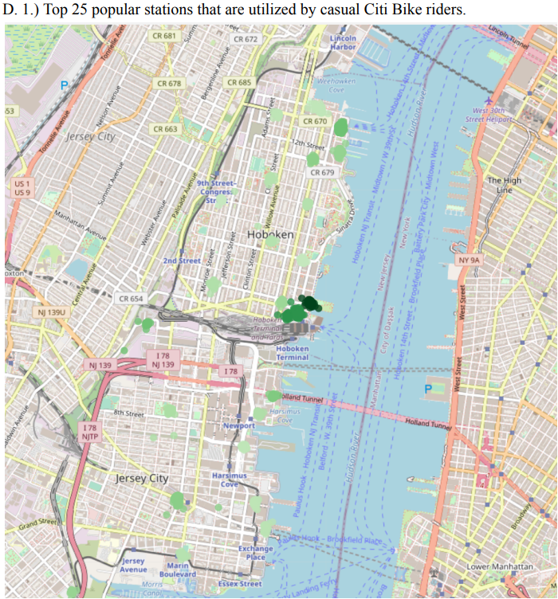
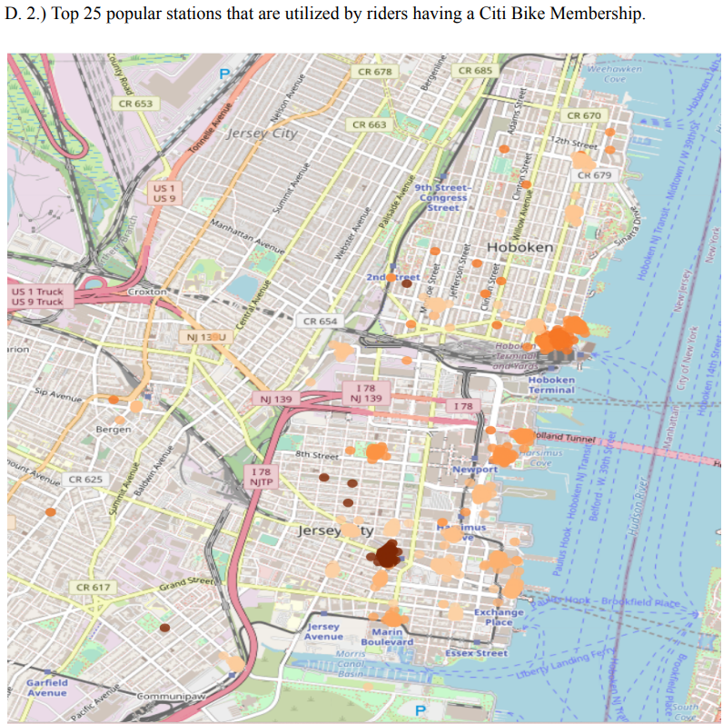
Utilization of popular station based on Citi Bike User types.

Slide 9
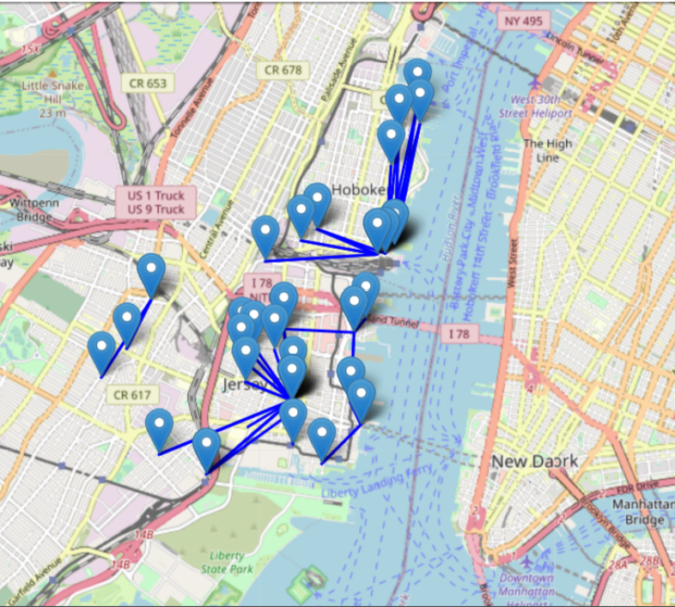
Popular routes accessed by Citi Bike riders.

Slide 10
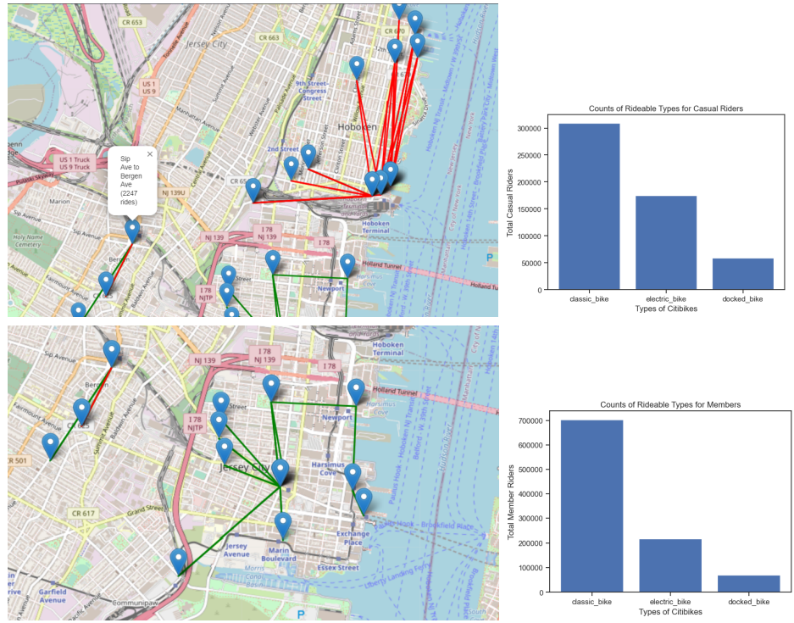
) Popular routes and Citi Bike Types distribution for casual users and users who have a Citi Bike Membership

Slide 11
Limitation and Conclusion
To present a more thorough picture of Citi Bike utilization in Hoboken and New Jersey and to make comparisons with other cities and regions that have created bike-sharing programs, additional research and analysis are required. Overall, this research lays the groundwork for further investigation and can assist in decision-making by Citi Bike and other bike-sharing programs in the region
Thank You…..

